Slide 1
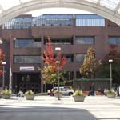
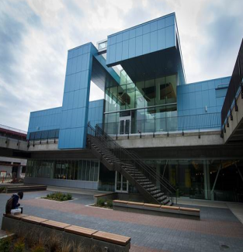
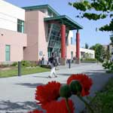
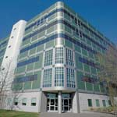
Central
SEATTLE COLLEGES
North
Public Budget Hearing
Fiscal Year 2016 - 2017
South
Presented June 15, 2016
Siegal Service Center
Dr. Jill Wakefield, Chancellor
SVI

Slide 2
Mission
Seattle Colleges
will provide excellent, accessible educational opportunities
to prepare our students for a
challenging future.

Slide 3
Strategic Plan 2010-2017
GOAL 1 – STUDENT SUCCESS
Increase Student Learning and Achievement:
Meet annual state-funded enrollment allocation Achieve 100% of our enrollment target
Increase student completion and job placement
Improve student achievement in pre-college math
Notes:
We achieved 96% of our enrollment target this year and if we had achieved 100% we would have increased tuition revenue by _______

Slide 4
Strategic Plan 2010-2017
GOAL 2 - PARTNERSHIPS
Build Community, Business and Educational Partnerships:
Increase Seattle Colleges’ economic impact and integral role in advancing social equity and social mobility.
Increase professional-technical program graduates to respond to local industry workforce needs
Increase private, foundation and local funding

Slide 5
Strategic Plan 2010-2017
GOAL 3 - INNOVATION
Increase innovation & improve organizational effectiveness:
Increase innovative instructional options for students
Improve effectiveness, efficiency and responsiveness of administrative systems
Increase employee ethnic and racial diversity and recognition

Slide 6
FY1617 Budget Issues
SBCTC Allocation Formula impacts
Enrollment and Student Success
Faculty and Staff wages
Foreboding Legislative session on the horizon

Slide 7
District Priorities for this Year
FY1617 Budget Priorities
Enrollment
Student Success Initiatives
Major Fund-raising Campaign
ctcLink
Future financial viability

Slide 8
SEATTLE COLLEGES
Financial Outlook
Fiscal Year 2016 - 2017
Dr. Kurt Buttleman
Vice Chancellor, Finance & Technology

Slide 9
FY1617 Budget Outlook
McCleary Decision (K-12) funding impacts
Faculty and Staff Wages
Earmarks (Pacific Tower, Labor Center, Maritime,
STEM, Aerospace)
BAS Tuition decreased by 15%
Capital
SCC Maritime Academy
SSC Integrated Education Center
NSC Library
SBCTC Allocation Model

Slide 10
FY1617 Budget Outlook
Key Updates to the SBCTC Allocation Model
Enrollment performance emphasis
Performance Funding (Student Achievement Awards) increased to 5%
High Priority Programs
Limit on “counting” of International FTES (2%)
Net impact to the Seattle Colleges
Reduction of $3.7M over 4 years (2017 – 2020)
Additional impact of lost tuition ($2M - $3M)

Slide 11
FY1617 Budget Outlook
Financial Management at Seattle District
Board of Trustees Priority
Viable financial model / New revenue stream
Long range planning
International Student uncertainty
$15 / hour impacts
Negotiated agreements impacts
Staff / Faculty salaries
ctcLink

Slide 12
District Office and District-wide
Key Discussions
Focus on Strategic Goals of Student Success, Building Partnerships, and Innovation
Creative Funding options such as grants and contracts
Focus on streamlining administrative activities
Reduction planning
Increased fixed costs

Slide 13
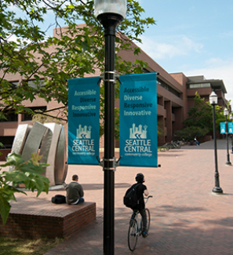
SEATTLE CENTRAL
Public Budget Hearing
Fiscal Year 2016 - 2017
Financial Outlook
Bruce Riveland
Vice President, Administrative Services
Instruction and Finance

Slide 14
SCC & SVI FY2016-17
Challenges
Declining enrollments (as of end of Winter 2016)
Central ~87% of target (630 FTEs under goal)
SVI ~55% of target (231 FTEs under goal)
Decreasing tuition and state revenue
Increasing operational costs
2% ceiling on the conversion of international students
SBCTC’s new allocation model for 2016-17

Slide 15
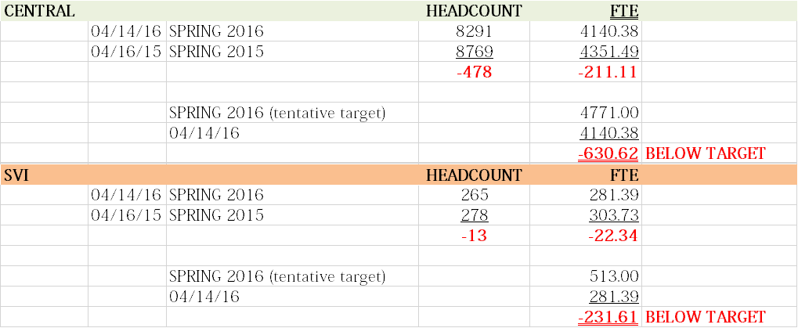
SCC & SVI
Enrollment Picture

Slide 16
SCC BUDGET PLANNING
Strategic Priorities for FY2016-17:
Increasing Enrollment, Retention and Completion
Eliminating Institutional Racism, and Achieving Equity and Diversity
Building Community

Slide 17
SCC BUDGET PLANNING
Budget Planning Principles for FY2016-17:
Maintaining current base funding level(s)
Sustain/increase FTEs
Engage employee in strategic enrollment
Using reserves to offset cut in tuition allocation for 2016 - 2017
Use remaining carry-forward savings
Use part-time faculty funding strategically to achieve priorities
As necessary, shift part-time faculty funding to programs with high FTE generation

Slide 18
SCC BUDGET PLANNING
Budget Development & Planning Process for
FY2016-17:
Only one-time requests
Each major unit (Instruction, Student Services, Admin Services, & President’s Office) will draft proposals to be ranked by the College Council Resource Allocation Sub Committee (RASC)
College Council RASC will make recommendations to the Cabinet
Instructional Administrators will develop part-time budget
President’s Cabinet will review and make decisions on budget proposals

Slide 19
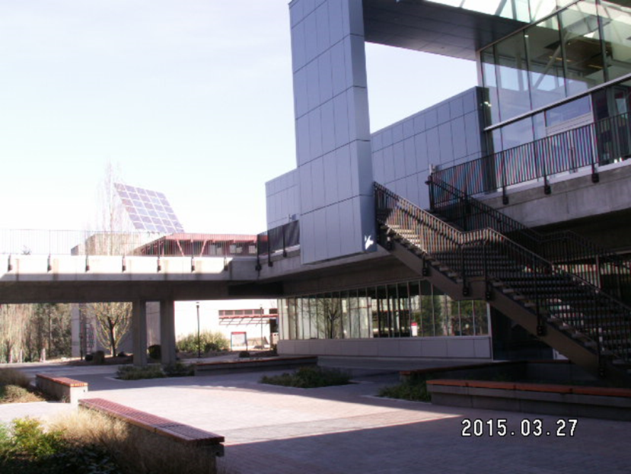
NORTH SEATTLE
Public Budget Hearing
Fiscal Year 2016 - 2017
Financial Outlook
Andrea Johnson
Vice President, Administrative Services

Slide 20
NORTH SEATTLE

Slide 21
NORTH SEATTLE
Guiding Principles
NSC Controlled Guiding Principles:
NSC will continue to engage external groups, employers, and elected officials to advocate for North and educate them on how their support helps the college fulfill its mission, even, and especially, as state operating budgets decline.
NSC will follow our currently stated core themes, mission, vision, and values in the way we treat people as we consider how budget reductions will affect our community. These values include: caring, collaboration, diversity, innovation, integrity, and quality.
NSC will meet all requirements of its varied collective bargaining agreements.
NSC will strive to protect FTE generating and “student-facing” programs as best as possible, while looking at the overall program costs related to FTE generation.
NSC will review all open/unfilled positions through a more stringent process in order to minimize reductions on currently employed staff.

Slide 22
NORTH SEATTLE
Guiding Principles
NSC Controlled Guiding Principles:
NSC will strive to protect, whenever possible, positions funded with permanent funds.
NSC will consider program fiscal viability in budget decisions. For example, programs that are considered auxiliary, or self-sustaining must have operating balances that will support their operation.
NSC will respect the uniqueness, health and quality of our varied programs. Across the board cuts, although seemingly equitable, have unequal impacts to students and should be avoided.
NSC will require that if any reserve funds are used for permanent budget purposes, a detailed and accountable strategy must be put in place to ensure the reserve funds are replenished.
NSC will closely scrutinize contracts and grants to determine if they are sustainable in both the short and long-term.

Slide 23
NORTH SEATTLE
The State Budget Challenges
New State Allocation Model
3% Reduction to NSC’s State Operating Budget (approx. $600,000 in permanent reductions for FY 2016-17)
Additional Permanent Cuts Thru FY 2019-2020 (approx. $74,827 per year)
Tuition Reduction

Slide 24
NORTH SEATTLE
President’s Reductions
Targeted Budget Reduction at 3% = $40,594
Amount Budget Reduced = $24,097
Reduced Goods and Services Across Presidential Reporting Areas and Councils (e.g., DICE)
Reduced Travel Budget
Future Questions Remain for District-wide Consolidation of Positions

Slide 25
NORTH SEATTLE
Instruction Reductions
Targeted Budget Reduction at 3% = $497,831
Amount Budget Reduced = $194,544
Positions Eliminated:
Associate Dean of Teaching and Learning
AA 4 – Workforce
Associate Dean of E-Learning
Director of Strategic Initiatives
XX

Slide 26
NORTH SEATTLE
Student Services Reductions
Targeted Budget Reduction at 3% = $75,254
Amount Budget Reduced = $40,312
Restructured Testing Office
Recaptured Remaining Funds From Personnel Turnover
Eliminated Lead Counselor Stipend
Eliminated Remaining Funds and Line Item for Former Dean for SDS position (i.e., Marci’s former position)

Slide 27
NORTH SEATTLE
Administrative Services Reductions
Targeted Budget Reduction at 3% = $132,946
Amount Budget Reduced = $132,946
Reduced Goods and Services
Recaptured Remaining Funds From Personnel Turnover
Shifted Targeted Hourly Positions To Revenue Budgets
XX

Slide 28
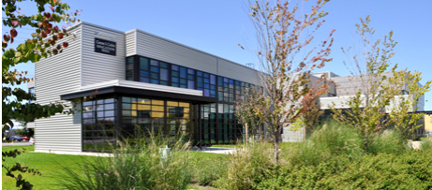
SOUTH SEATTLE
Public Budget Hearing
Fiscal Year 2016 - 2017
Financial Outlook
Dr. Frank Ashby
Vice President, Administrative Services

Slide 29
FY1617 Budget Issues

Slide 30
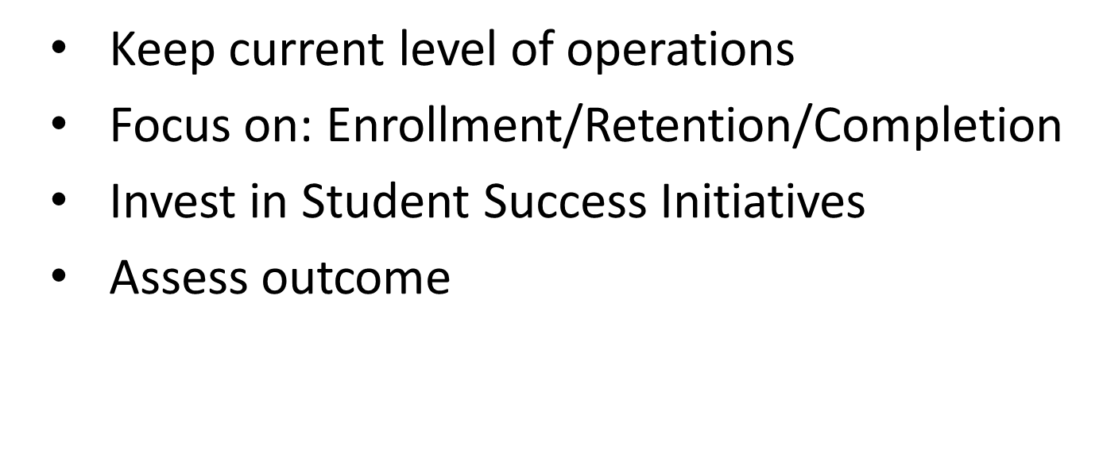
FY1617 Budget Priorities

Slide 31
Strategic Directions
Provide current, high quality instructional programs
Create a structured student experience
Build a continuous improvement plan into all college
activities
4. Deepen and expand our connections to our
community
Procure and allocate sufficient resources to meet our
mission
Foster and strengthen equity, inclusion, and cultural
competency

Slide 32
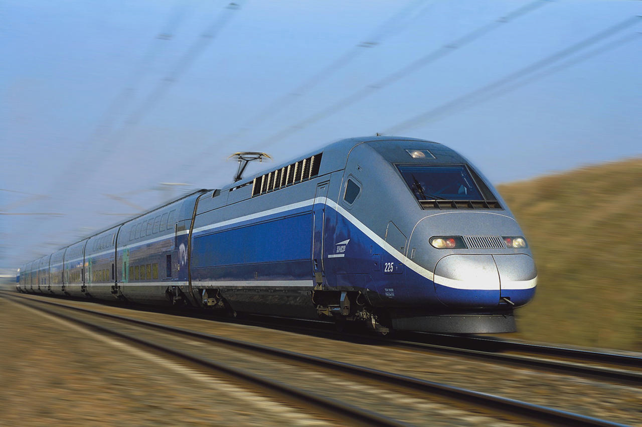
Next Stop
South 2017

Slide 33
College Council acknowledges that “resources are very scarce this budget cycle”. College Council recommends: 1. Mandatory items to be given the first funding priority 2. Science Lab technician - strongly recommend 3. Completion Coach (6 months) – strongly recommend 4. Equity, Diversity & Inclusion ($6K) – recommend College Council also mentions: 1. All divisions kept requests to minimum and it shows 2. College to consider some requests that will be necessary long term 3. College to work on “revenue” side of equation in terms of: retention, schedule, class offer, and program mix.
College Council Recommendations

Slide 34
Budget Balancing FY1617
Description | Amount
Allocation/Tuition shortfall | 750,000
Unfunded Mandates & Contractual Obligations | 645,000
Approved Requests | 102,050
Total Need: | $1,497,050
Approved Changes | 1,472,500
Total Resources: | $1,472,500
Budget Gap: | (24,550)

Slide 35
Approved Changes FY1617
Item | Amount
Cost Recoveries Contribution | 500,000
Corporate & Contract Training self support | 21,500
NSF Grant match to grant consolidation | 26,500
DSHS ORIA position 100% on grant | 11,500
Special Allocation Administrative Cost | 70,000
IT and Media cost transfers on fee | 45,000
Personnel reorganization | 47,000
Transfer cost to auxiliary budgets | 11,000
Official Operating Reserve | 750,000
TOTAL: | $1,472,500

Slide 36
FY1617 Budget Key Points
2016-17FY Permanent budget is NOT balanced
South use of one time reserve to close budget gap
Current level of funding in 2016-17FY for departments is NOT guaranteed.
Be prepared for more changes

Slide 37
Budget Hearing
Questions & Discussion?
Thank you all for attending

